Slide 1
Fintech 545
Assignment 4

Slide 2
Problem 1
Use the data in problem1.csv. Fit a normal Distribution and a Generalized T distribution to this data. Calculate the VaR and the ES for both fiited distributions.
Overlay the graphs the distribution PDFs, VaR, and ES values. What do you notice? Explain the differences.

Slide 3
Problem 1
Fit Normal Distribution with 10000 simulations:
sim_N = np.random.normal(np.mean(data1),np.std(data1),size=10000)
Fit T Distribution with 10000 simulations using MLE:
def MLE_T(p):
return -1*np.sum(stats.t.logpdf(data1, df=p[0], loc = p[1],scale=p[2]))
constraints=({"type":"ineq", "fun":lambda x: x[0]-1},
{"type":"ineq", "fun":lambda x: x[2]})
df, loc, scale = minimize(MLE_T, x0 = (10,np.mean(data1),np.std(data1)),constraints=constraints).x
sim_T = stats.t(df=df, scale=scale).rvs(10000)

Slide 4
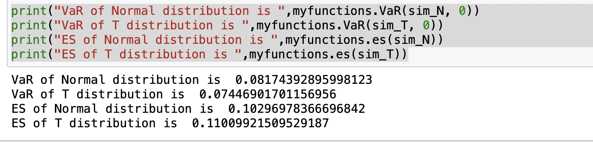
Problem 1
Calculate the VaR and ES using functions in ft545 package:

Slide 5
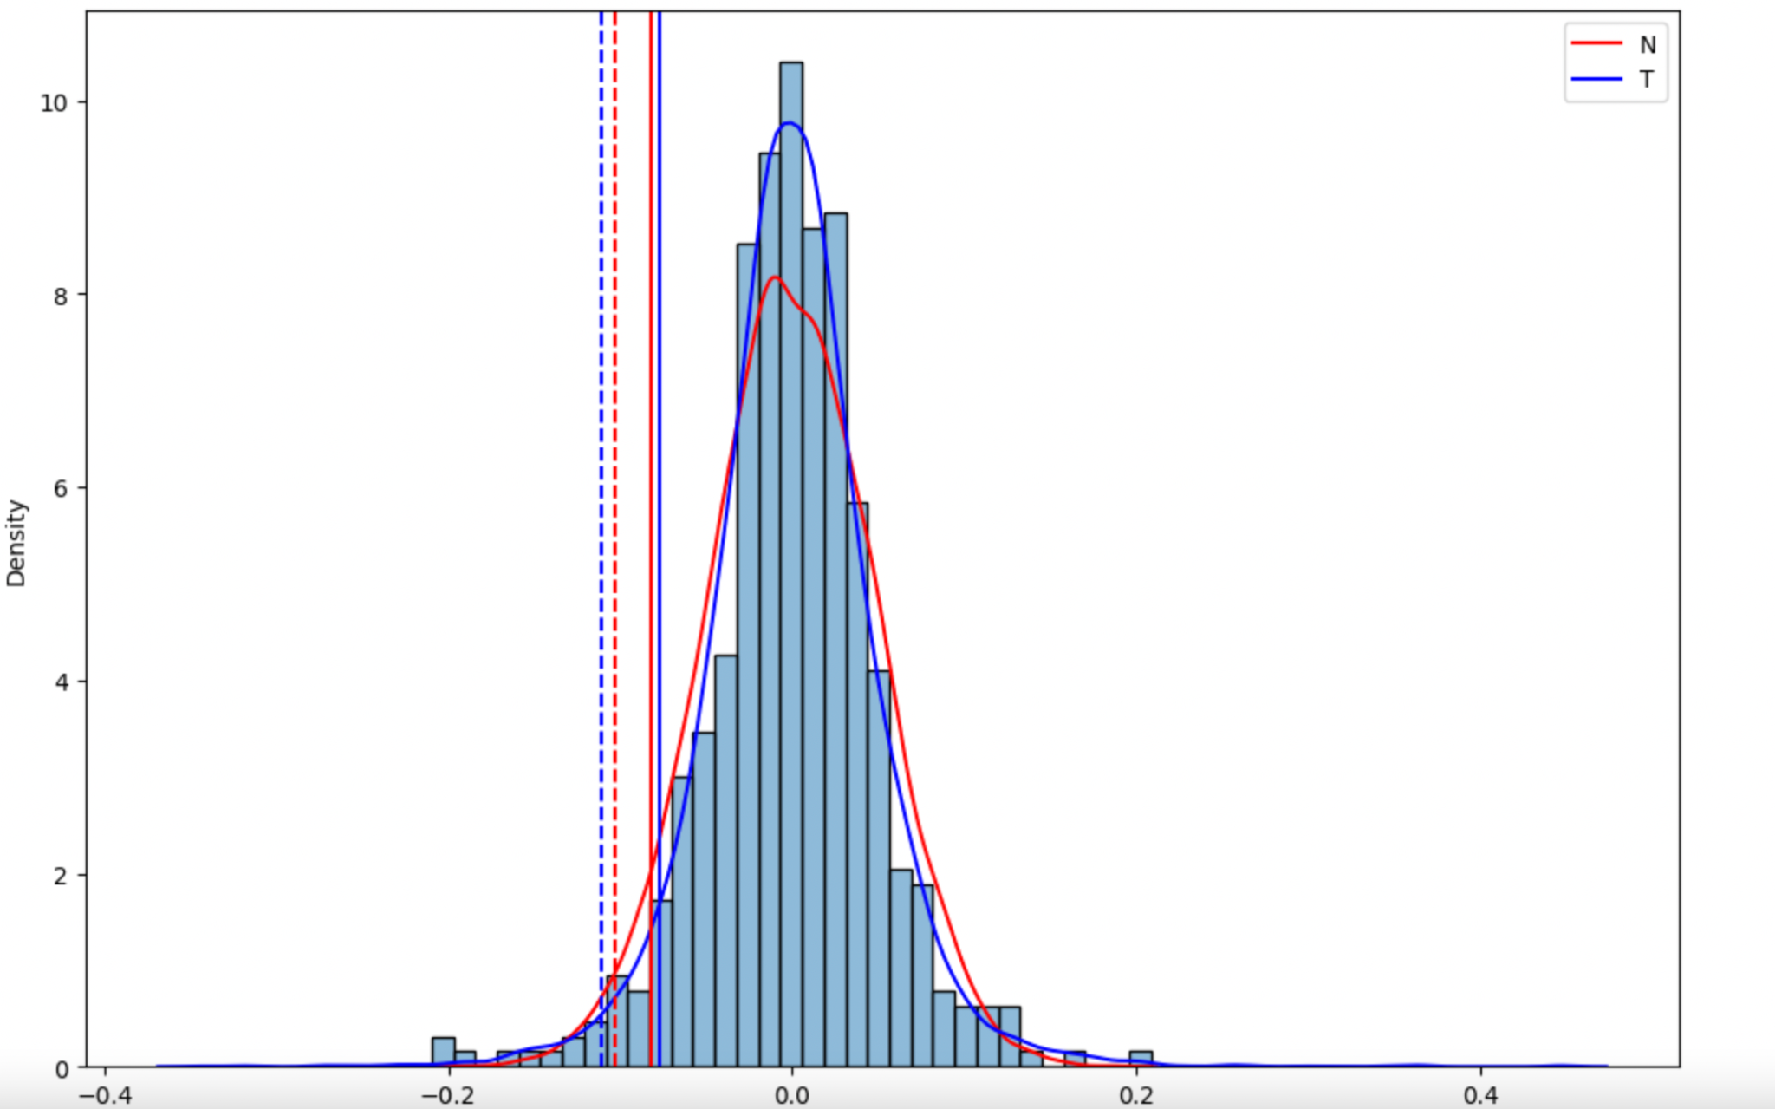
Here is the empirial data and fitted distributions

Slide 6
Problem 1
Conclusion:The solid lines are the VaR and the dotted lines are the ES. T distribution is a better fit of the graph because it has a greater kurtosis(fatter tail). The VaR of normal distribution is greater than that of T distribution and the ES of normal distribution is less than that of T distribution(loss is a positive number)

Slide 7
2. Problem 2
In your main repository, create a Library for risk management. Create modules, classes, packages, etc as you see fit. Include all the functionality we have discussed so far in class. Make sure it includes
Covariance estimation techniques
Non PSD fixes for correlation matrices
Simulation Methods
VaR calculation methods(all discusses)
ES calculation
Create a test suite and show that each function performs as expected

Slide 8
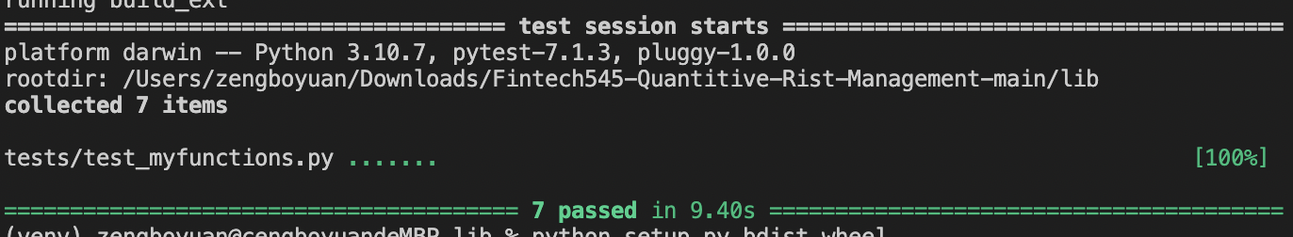
Problem 2
A library called ft545 is created and all the functions are in myfunctions.py. The detailed instruction is in README and here are the test results.

Slide 9
Problem 3
Use your repository from #2. Using Portfolio.csv and Daily Prices.csv. Assume the expected return on all stocks is 0. This file contains the stock holdings of 3 portfolios. You own each of these portfolios. Fit a Generalized T model to each stock and calculate the VaR and ES of each portfolio as well as your total VaR and ES. Compare the results form this to your VaR from Problem3 from Week4.

Slide 10
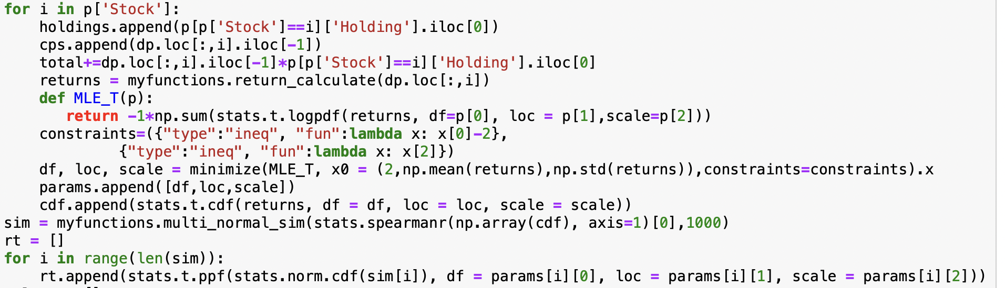
Problem 3
Since each stock is of T distribution instead of normal distribution, we need to fit each stock using T distribution first and then use Copula simulation.

Slide 11
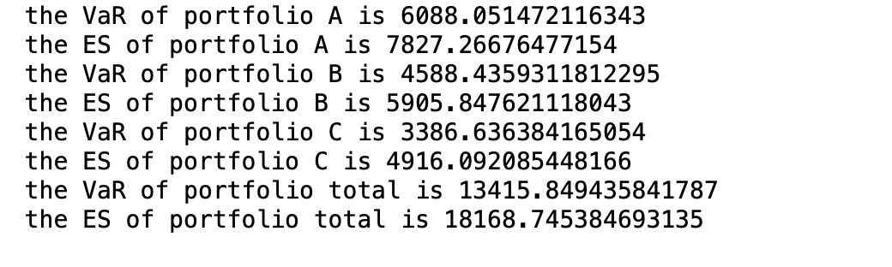
Problem 3
Results:

Slide 12
Problem 3
Conclusion: There are only little difference between the results here and the results from week4. However, simulation using Copulus should be a better fit if we have the right distribution of each stock because it does not require normality assumption.

